Slide 1

The Handling of Blessing
Deuteronomy 33:1,13-17
“Precious Things of Heaven”
Adult Bible Class
Deliverance Center

Slide 2
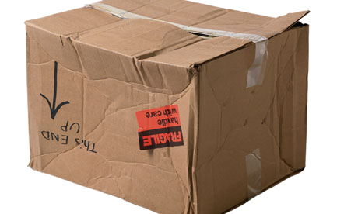
Watch How You Carry That!

Slide 3
Meaning of Precious
Genesis 24:53 Given to Rebekah precious things
-like a gem
I Samuel 3:1 The Word of the Lord was “precious in those days”
-valuable; brightness, clear, costly, excellent, fat, honourable women, reputation. [from 3365 to make rare]
Deuteronomy 33:13 “precious”
-eminent; a distinguished thing; hence something valuable

Slide 4
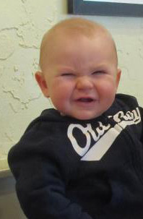
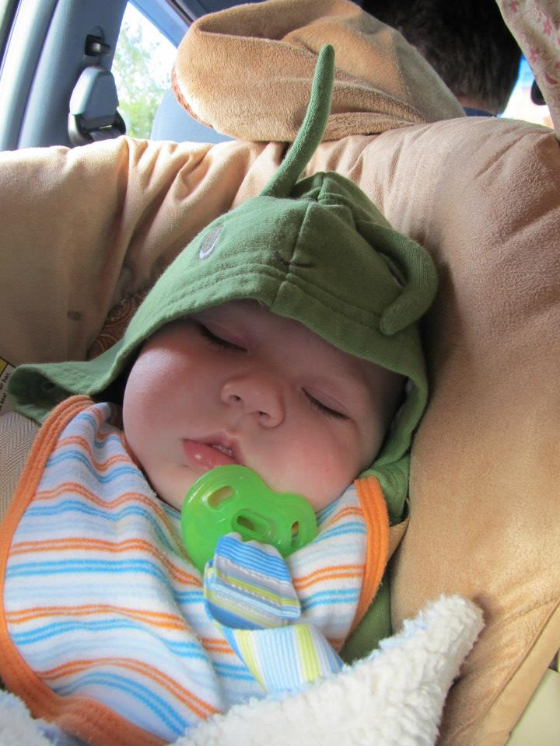
Precious Things of Heaven

Slide 5
Precious Things of Heaven
The dew, the deep waters, fruits of the sun, light of the moon, the majesty of the mountains, eternal hills, fields and their fullness, vs. 13-16
for the good will of him that dwelt in the bush, vs. 16
Precious Things We Can’t Duplicate
Precious Things We Can’t Fathom
Precious Things We Can’t Contain
Precious Things We Can’t Live Without

Slide 6
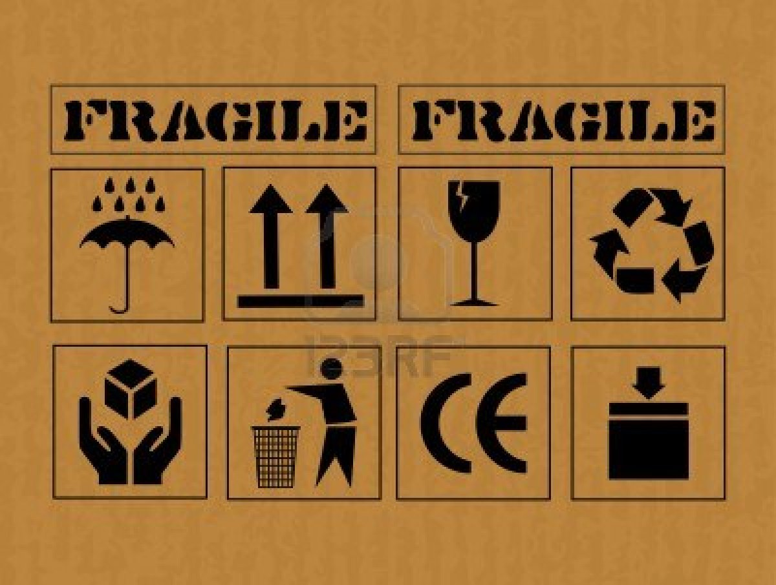
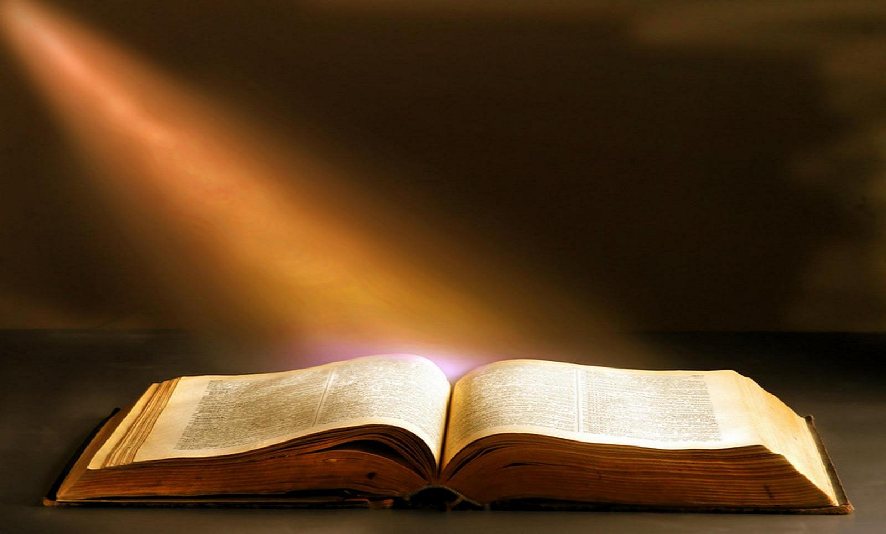
Handling Instructions

Slide 7
Handling Instructions
Lesson from CAIN,
Appreciation, Value
Lesson from UZZAH,
You don’t carry that Ark of God on a Cart!
Lesson from ICHABOD, I Samuel 4:1,10,11

Slide 8
Conclusion
If you HANDLE the Blessing right, God has more to come!

Slide 9
The Handling of Blessing
Deuteronomy 33:1,13-17
“Precious Things of Heaven”
Adult Bible Class
Deliverance Center

